Slide 1
Final Project Proposal Basketball movement tracking
Wei Hong (wh951)
Nan Wang (nw953)

Slide 2
1. Motivation
2. Technical Setup
3. Algorithms
4. Results
5. Short Review

Slide 3
1. Motivation

Slide 4
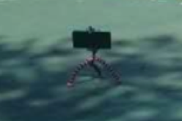
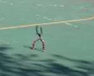
2. Technical Setup

Slide 5
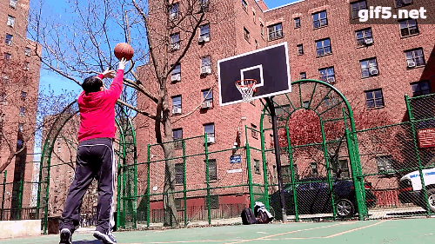
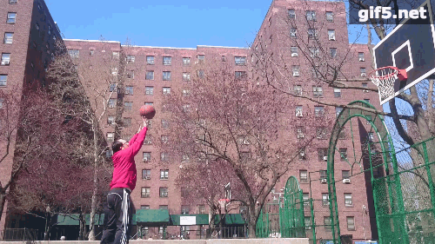

Slide 7
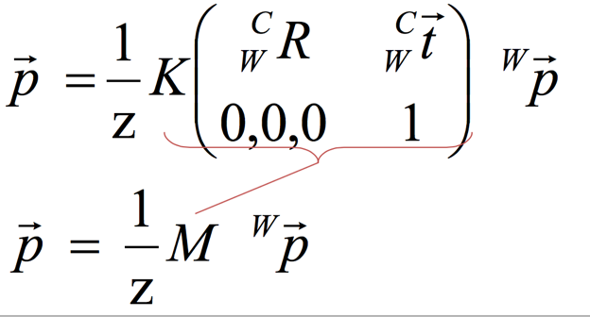
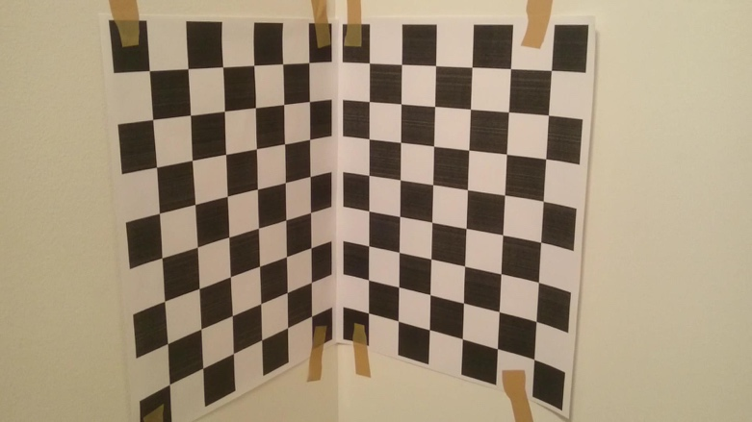

3. Algorithms
First things first: camera calibration
Intrinsic matrices $K, K^{′}$

Slide 8
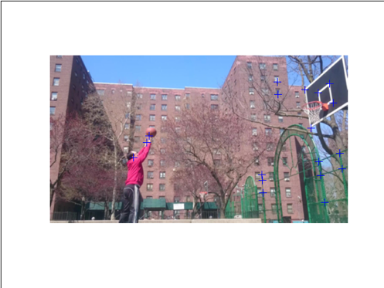
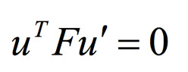
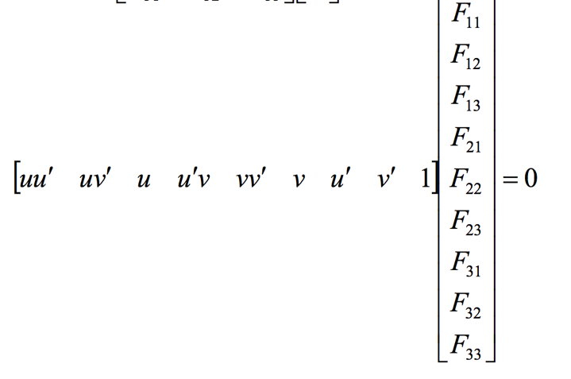
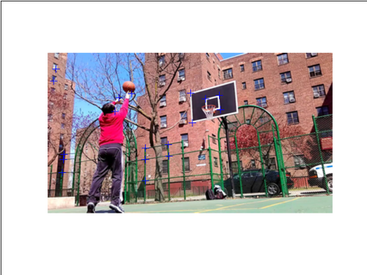



Calculating Fundamental Matrix and Essential Matrix
$$F$$
$$ℰ=K_{1}^{T}FK_{2}$$
$$ℰ$$

Slide 9
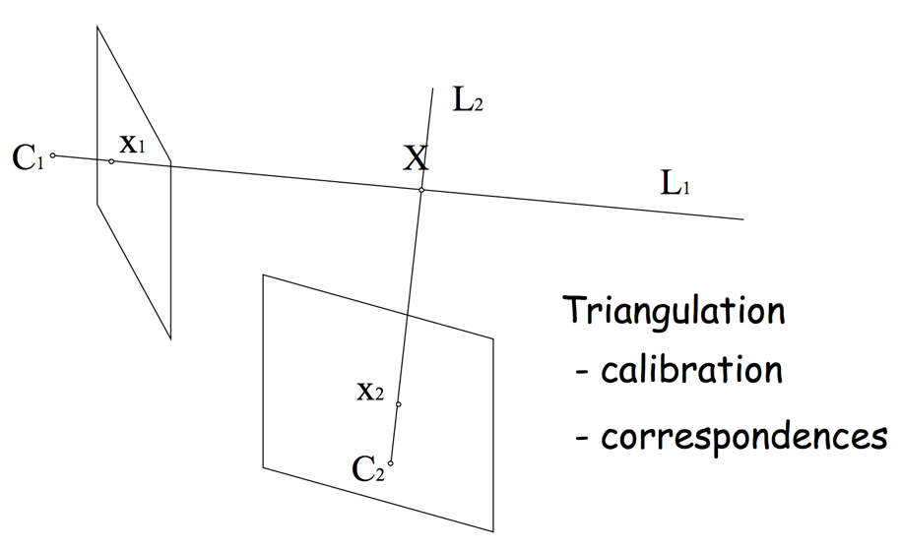
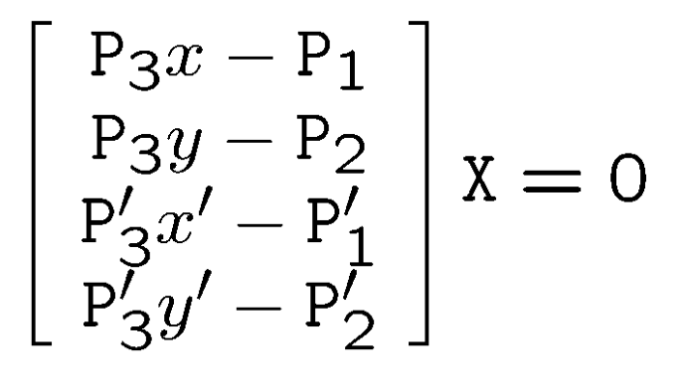

P and P’ map the world point X to sensor coordinates (x,y,1)
If we know P and P’, we can calculate X by
Triangulation
$$λx_{1}=PX$$
$$λ_{2}x_{2}=P′X$$

Slide 10
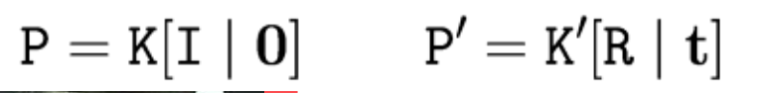
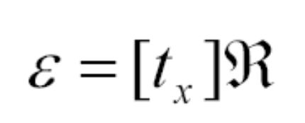
How to get P and P’?
By choosing the world coordinates the same as the camera coordinates of the first camera, we have
K and K’ already known. And For R and t remember
So, everything can be calculated.

Slide 11
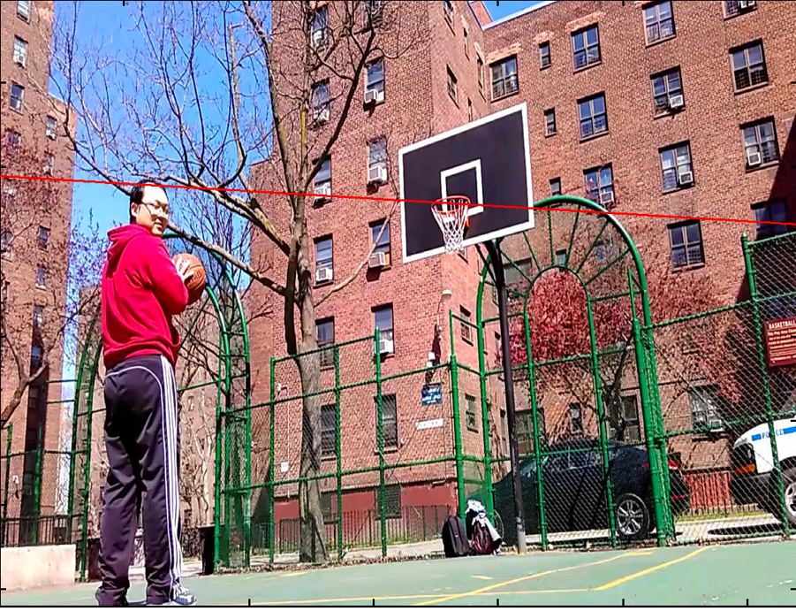
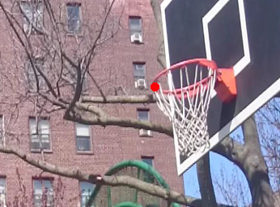
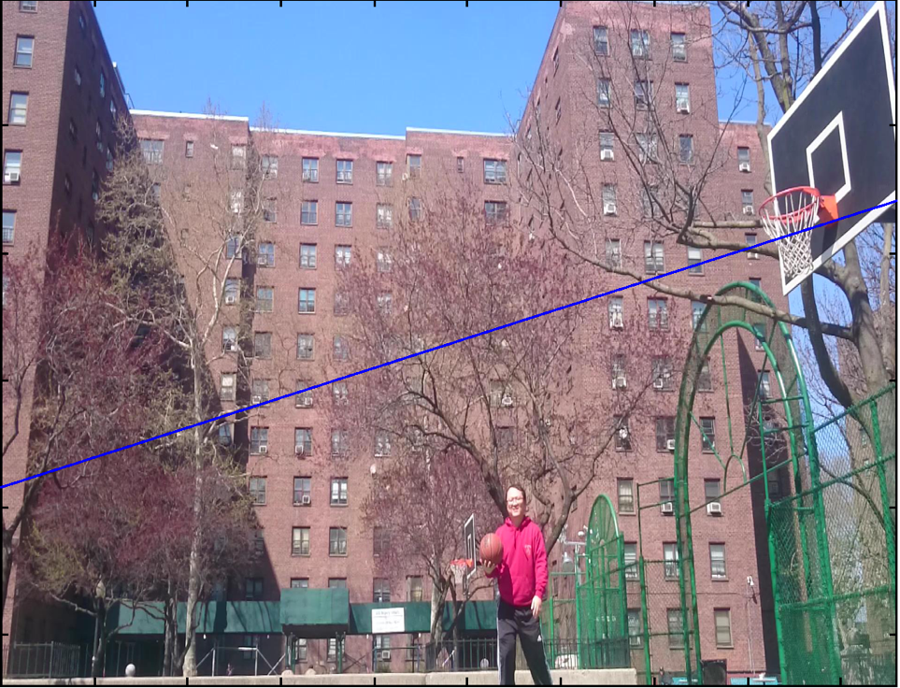
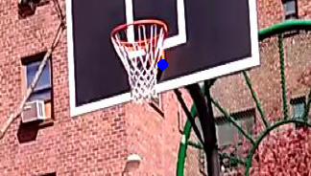
4. Result

Slide 12
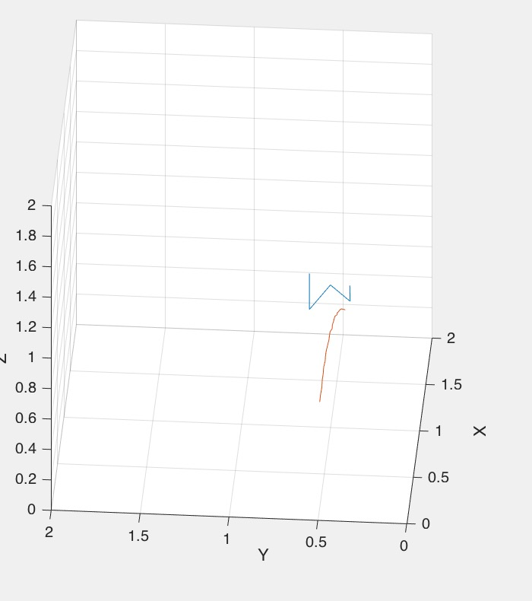
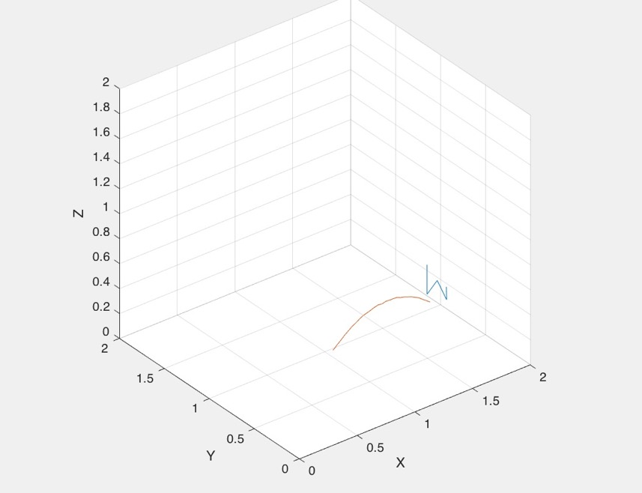

Slide 13
5. Short Review
To do in the future:
1. identifying the basketball in the images: item retrieving.
2. calculate the coordinates of the ball by using the simple perspective projection model with only one video camera, and provided the size of the basketball,

